Slide 1



Alternanza scuola-lavoro 2018/2019
SUIT

Slide 2








What we’ve learned during the ASL project
Start of ASL project
C
Git & GitHub
Databases & MySQL
Bootstrap
Web Servers & Apache
Vue.js

Slide 3
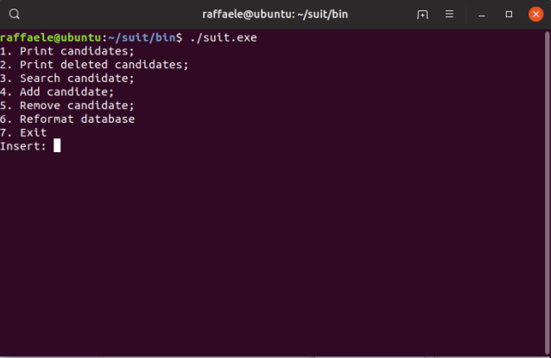
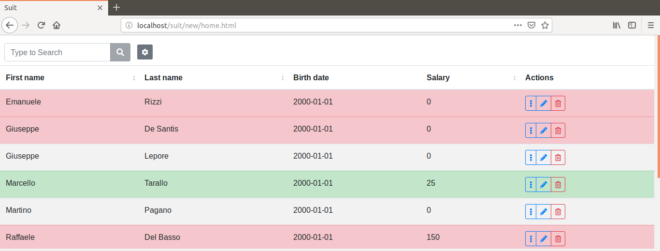
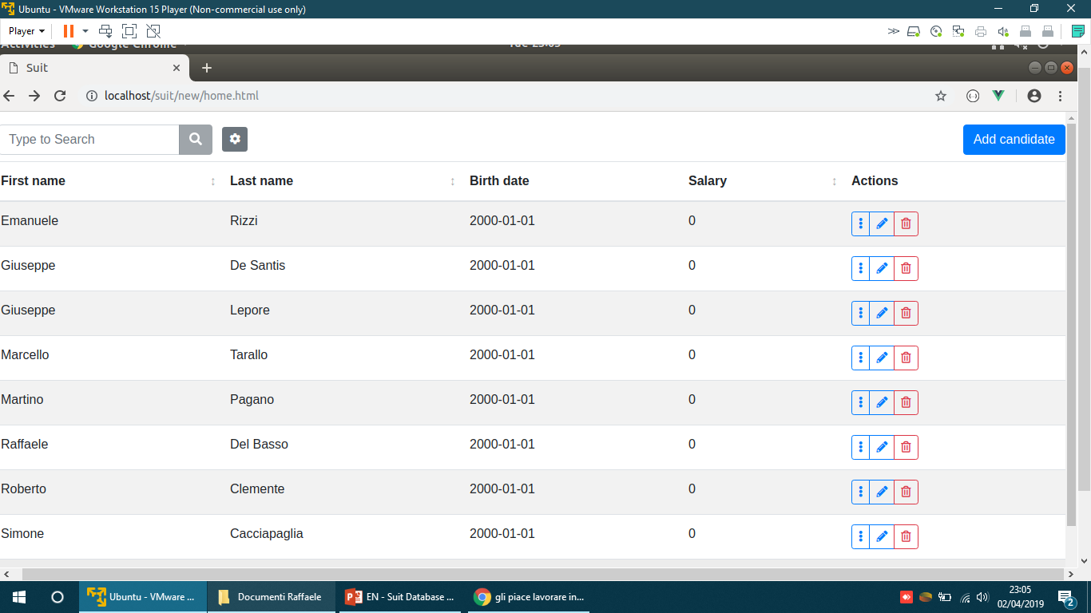


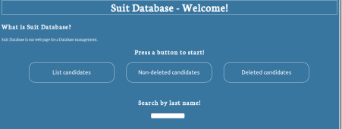

Software Timeline
CLI
Basic HTML GUI
Bootstrap + Vue GUI

Slide 4






How is it made?
Back-end
Front-end

Slide 5
What is «Suit»?
Suit is our HR management web app that aims to simplify the process of finding and hiring employees.

Slide 6
How does it work?
The software has a top section which contains the search bar and the filter panel, and the main section which shows the candidates in a table.

Slide 7
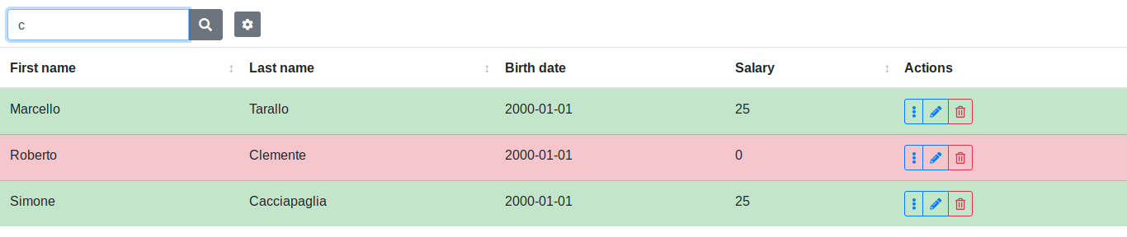
Search and filters • Search bar
The search bar allows you to search for a candidate by first name and last name using the incremental search method (case insensitive).

Slide 8
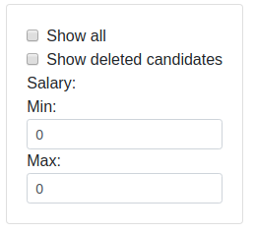
Search and filters • Filters
The following panel allows you to apply and combine filters for a more detailed search.

Slide 9
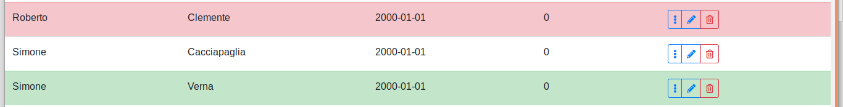
Rows and candidates
Rejected or hired candidate
Not deleted and not employed candidate
Employed candidate

Slide 10
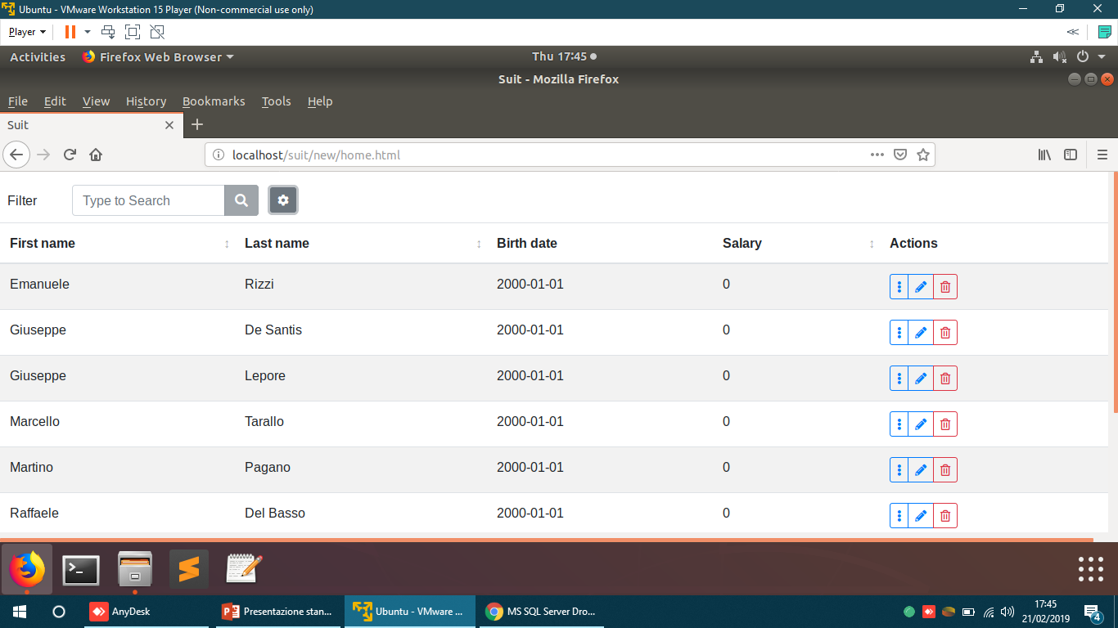
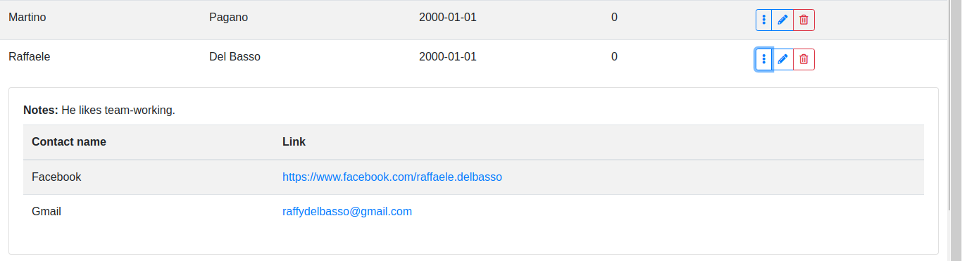
Action list • Details
This button allows you to see all the candidate information.
The row expands and shows the following information (if inserted):
Notes about the candidate;
All the contact links or mails which have been registered.
If you click on a web link, you will be redirected to the site you clicked (e.g., Facebook profile);
If you click on an email, your email client will open.

Slide 11
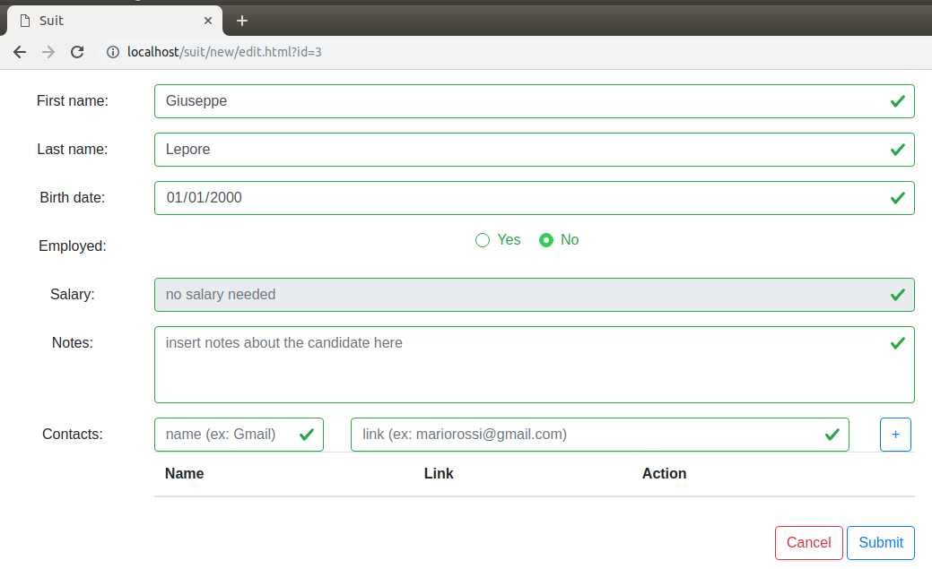
Action list • Edit candidate
This button lets you edit the candidate information.

Slide 12
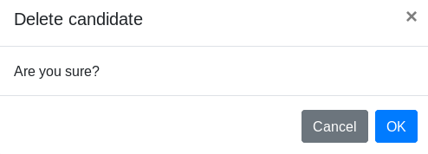
Action list • Delete candidate
This button lets you delete the candidate. It will still be possible to search for deleted candidates through the filter panel.

Slide 13
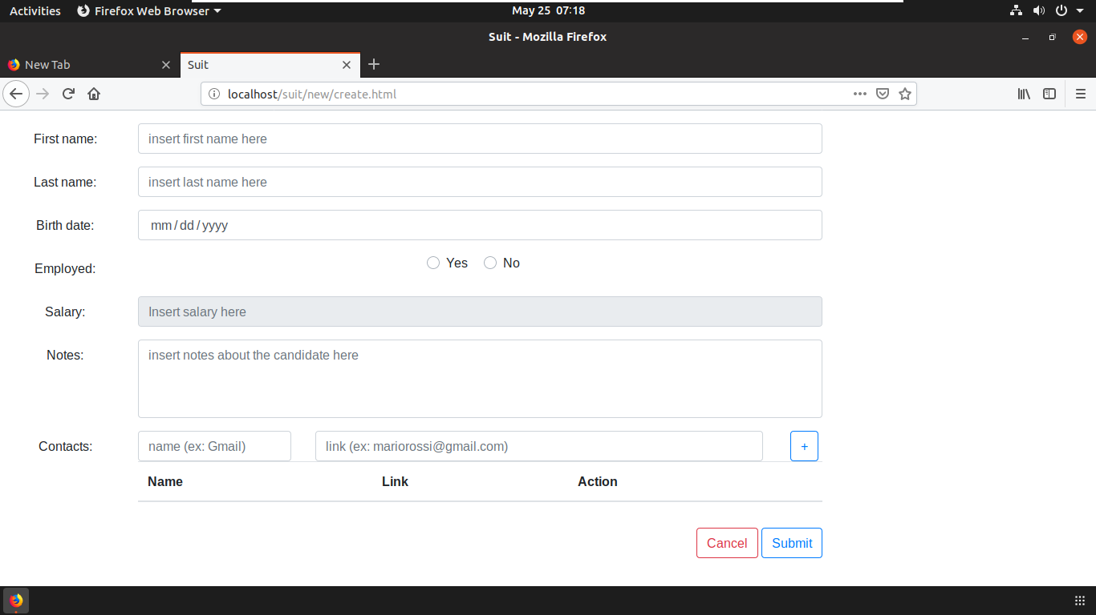
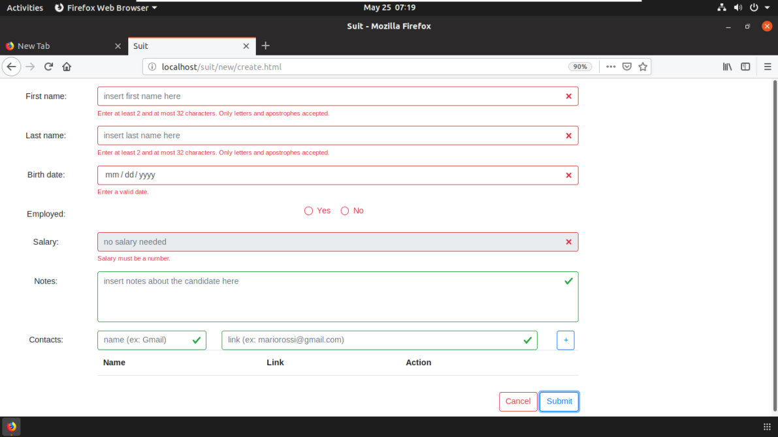
Add candidate
This button lets you add a new candidate.
The text fields are red when there is something wrong. Otherwise, they will be green. You can submit a candidate only if all the text fields are green.

Slide 14
Conclusions
Our software has the goal to help the company during the hiring process.
Coming features:
A better interface;
New filters.
The app might be updated in the future to allow to manage all the employees becoming a more general tool for the company.
GitHub project link: https://github.com/lt-scuolalavoro/suit

Slide 15

Thank you for the attention.

Slide 16
Backup slides
Deploy
What’s Alternanza Scuola-Lavoro?
Why C + CGI?
Why JSON?
Why Bootstrap + Vue?
New filters
Better GUI
DB Versioning System

Slide 17

Deploy
To run the software you need to read and follow the instructions located in the GitHub repository wiki.
Link: https://github.com/lt-scuolalavoro/suit/wiki

Slide 18
What’s Alternanza Scuola-Lavoro?
Alternanza Scuola Lavoro (School – Work experience model) is the innovative educational discipline which allowed us to ‘work’ for the company during our school years.
During the last two years we alternated school days with work ones, in which we discovered the working life and how it feels.

Slide 19
Why C + CGI?
We used C and CGI in the backend essentially because we studied C during our last school year.
Even if we know that C is not the most suitable language for this kind of application, we wanted to use our C knowledge to achieve our goals, in order to get a deeper understanding on what we were doing.
Another reason is that C is still one of the fastest languages in the computer science industry and we got the proof of it during the development of this project.

Slide 20
Why JSON?
We needed to let the db communicate with the frontend frameworks (Bootstrap + Vue), so we found JSON the easiest way for us to do that.

Slide 21
Why Bootstrap + Vue?
These two frontend frameworks simplified the GUI design and develompent due to their flexibility and their approachability.

Slide 22
TODO: New filters
We are going to add new filters like:
Order the table by record insertion date
Order by age
Show only unemployed candidates
Show only employed candidates

Slide 23
TODO: Better GUI
We want to improve the GUI adding more feedback messages that aim to enhance and make easier the user experience.

Slide 24
DB Versioning System
We created a database versioning system to automate the process of updating the database schema and data on every machine.
We use sql and sh scripts to execute queries automatically.
Everything is managed by a shell script called ‘db_update.sh’ at the moment.
It checks the current version of the database and updates it to the latest version.
We are designing a better modular script capable of execute single or multiple operations by the use of arguments (e.g. –help for synopsis , etc.).

